Slide 2
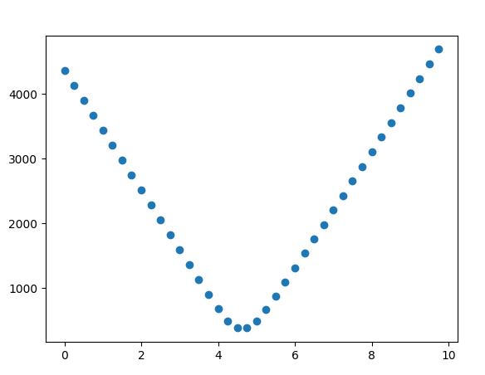
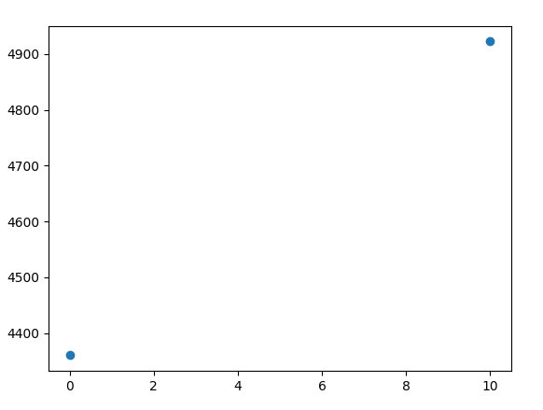
Auto Fluorescence Scale Factor Guess
mean[abs(Image – X*autoF)]
What if not know scale factor between image and autoF image?
Minimize metric of mean[abs(Image – X*autoF)]
Turns out to be monotonic (makes perfect sense)
If use inverse weighted average between lowest two points, you can estimate the X value where the metric is minimized
Given its monotonic, this should still be valid as we reduce points. Even down to just two
X
Min guess = 4.62
mean[abs(Image – X*autoF)]
X
Min guess = 4.70

Slide 3
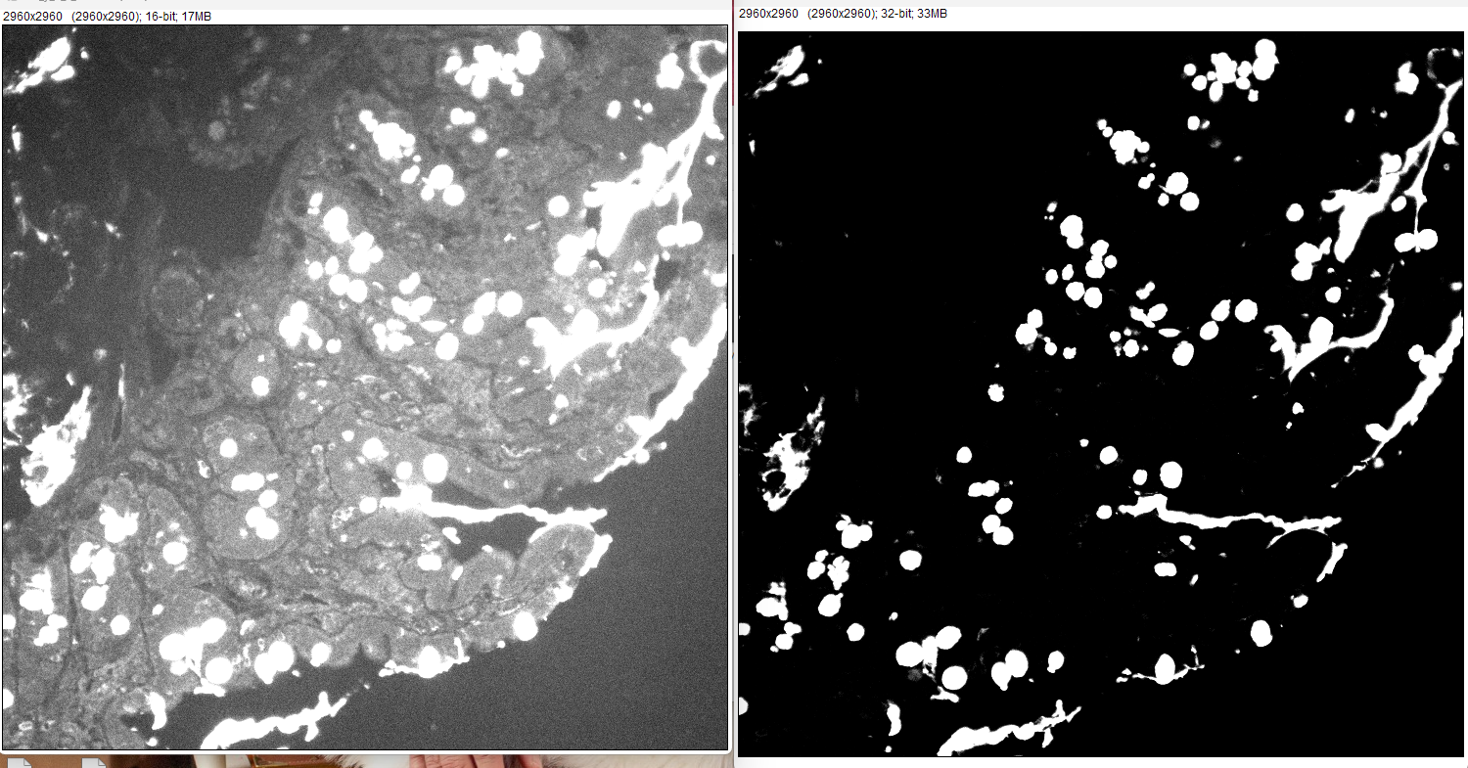
Example Subbed Images

Slide 4
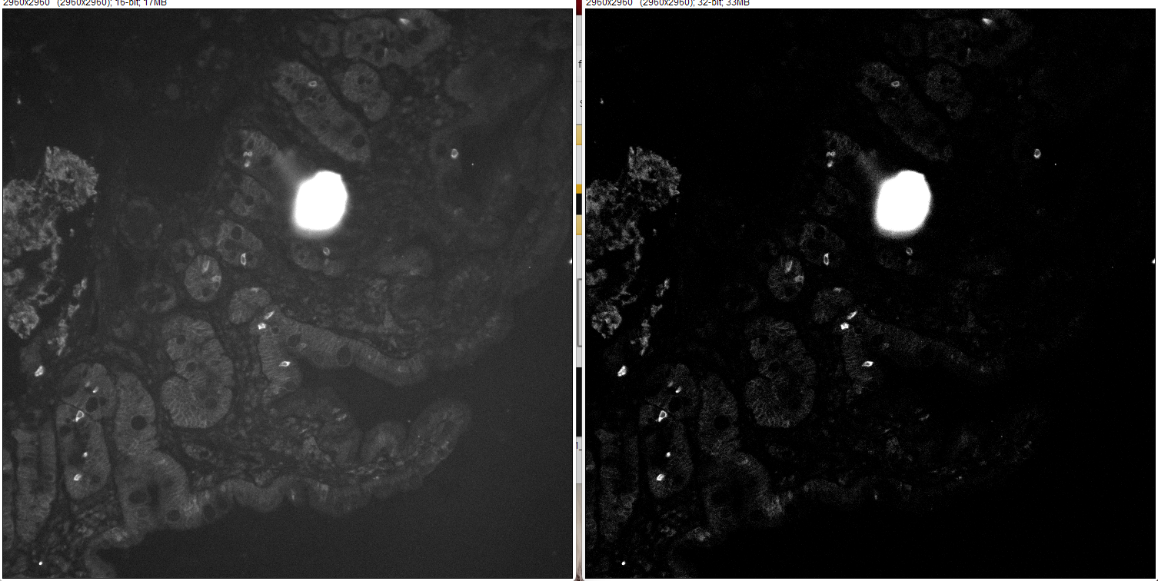

Slide 5
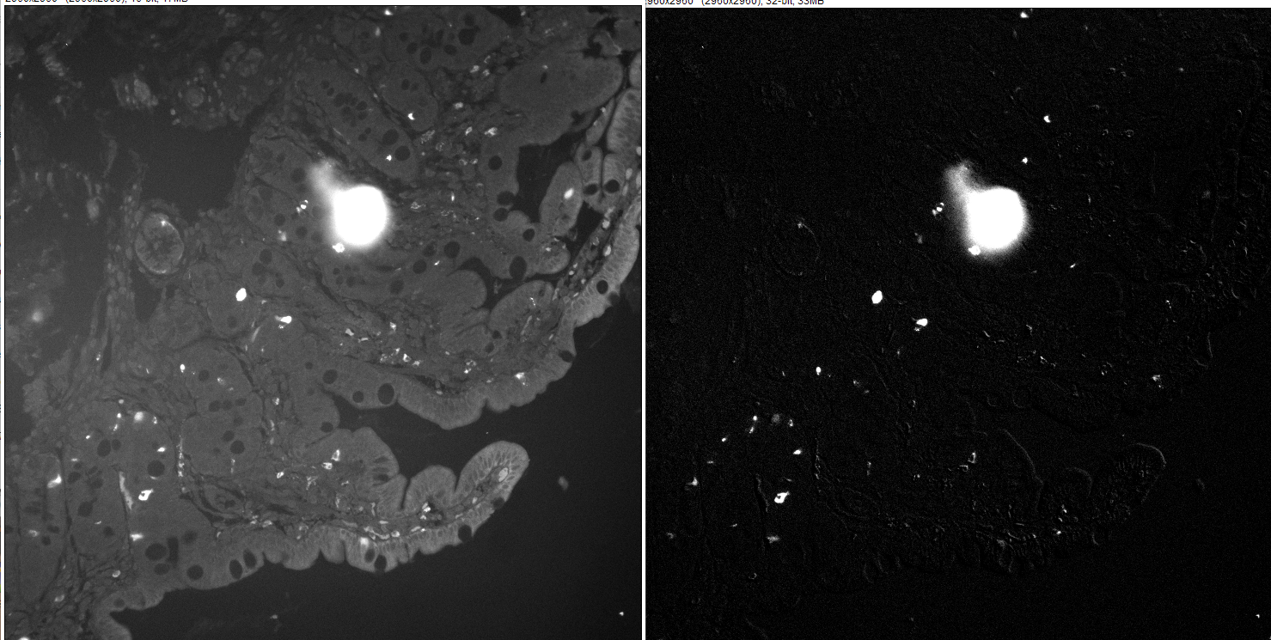

Slide 6
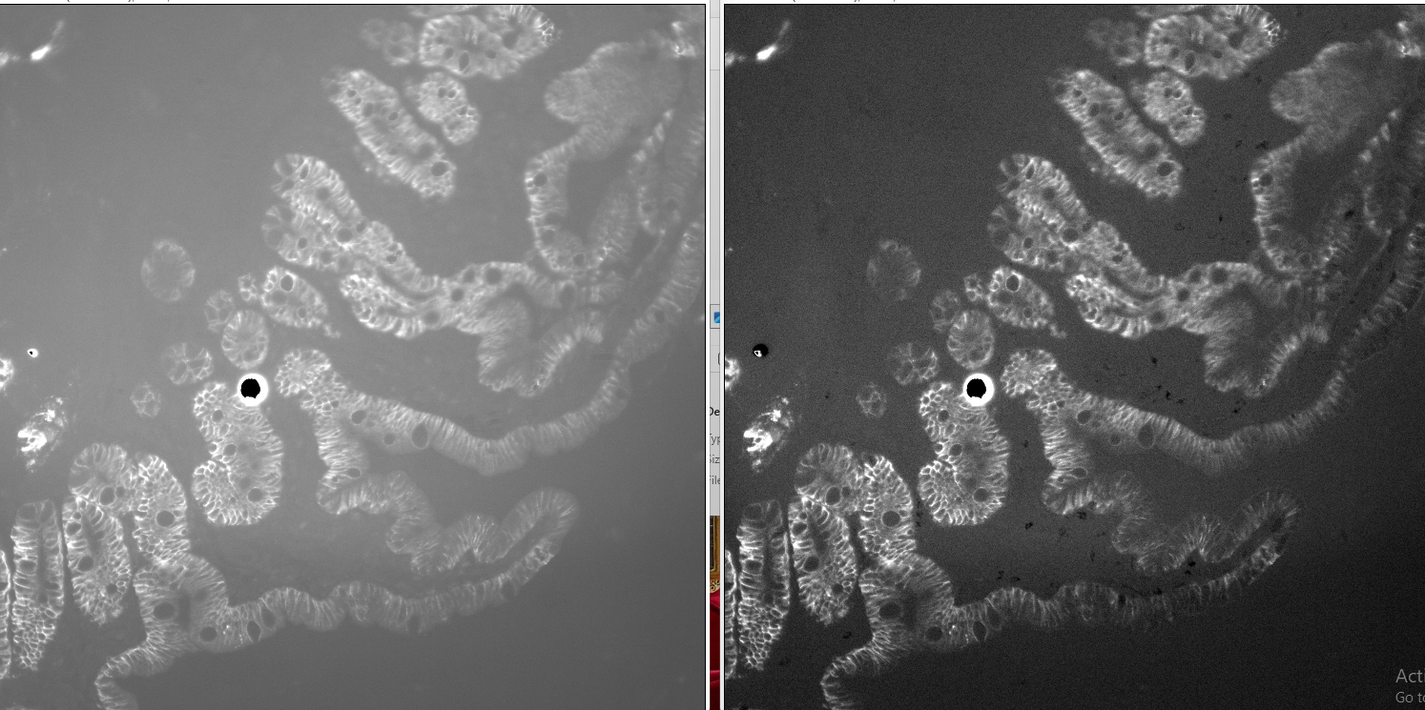

Slide 7
Steps to Auto Exposure
Perform dynamic background sub
Use tissue binary to screen out off tissue pixels
Otsu threshold non-zero pixels that exist after step 2
In above thresh pixels, remove dimmest 1% of pixels
Use resulting dimmest pixel to determine exposure time (based off of subbed image)
Use unsubbed image to determine brightest pixels.
Use brightest to determine if it can be acquired in one shot or multiple shots (ie does the frame have enough dynamic range for well exposed bright and dim pixels at same time). Reason is I care about actual stained strength for exposure time, but auto F is always captured so must be taken into account for actual image acq and dynamic range occupied.

